Slide 1

5 PILLARS OF ISLAM
Presented by:
Hamza Mehmood Fatima Wahid
Ahad Ali Fayaz Ahmed Uzair Sajid

Slide 2
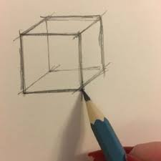

The Meaning Of Islam
The five pillars of Islam give you the framework that gives schedule, controls and state of mind necessaries to prepare you into the real actions.
It is the first to understand as a Muslim to get started and practice Islam fully.
There are five pillars of Islam will be discussed and breakdown as follows:

Slide 3
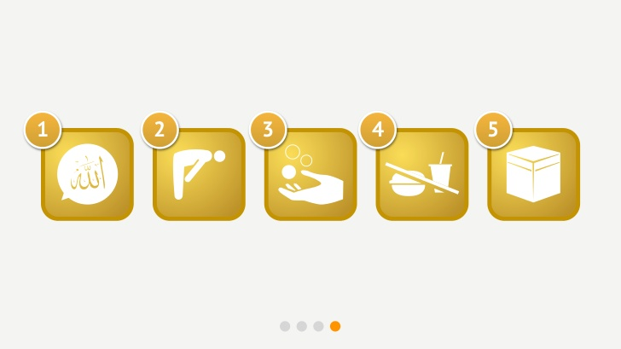

Pillars of Islam

Slide 4
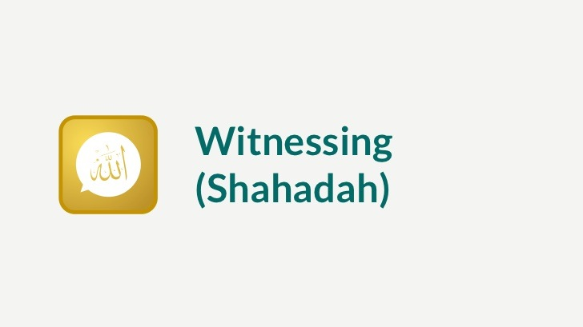
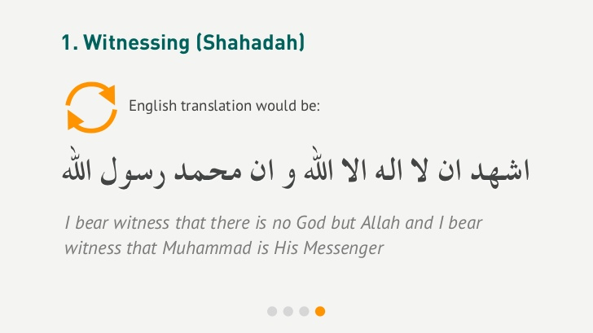
Witnessing (Shahadah)
The witnessing of the Oneness of Allah is the rejection of any form of deity other than Allah.
And the witnessing that Muhammad is his Messenger is the acceptance of him being chosen by Allah to convey His message of Islam to all humanity.
And to deliver it from the of ignorance into the light of belief in, and knowledge of the creator.

Slide 5
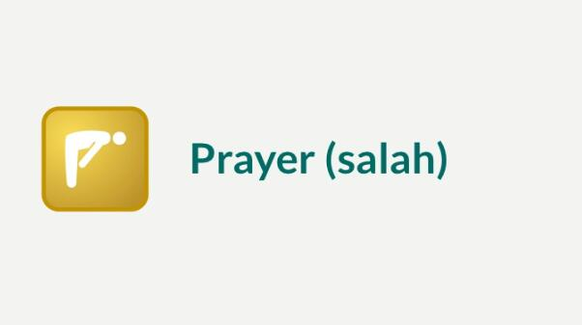
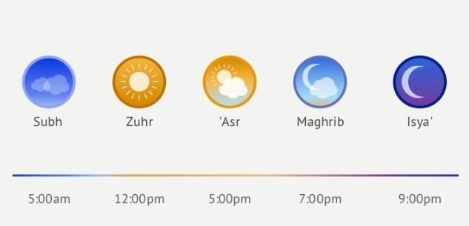
Prayer (Salah)
Allah does not need man’s prayer because he is free of all needs.
Prayer is for our immeasurable benefits, and the blessings are beyond imagination.
Every muscle of the body joins the soul and the mind in the worship and glory of Allah.
The Prophet(SAW) said:
“The key to paradise is prayer, and the key to prayer is Wudu”.

Slide 6

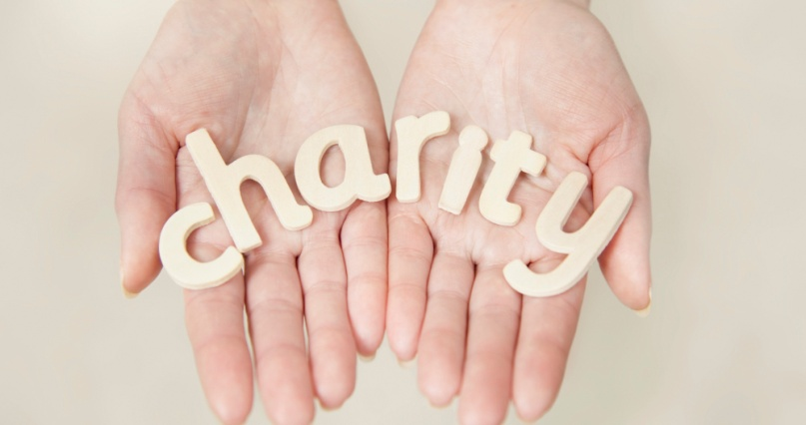
Charity (Zakah)
The literal meaning of Zakah is purity and it refers to the annual amount in kind which a Muslim with means must distribute among the rightful beneficiaries.
Zakah does not only purify the property of the contributor but also purifies his heart from selfishness and greed.
The Prophet (SAW) said:
“Give charity without delay, for its stands in the way of calamity”.

Slide 7
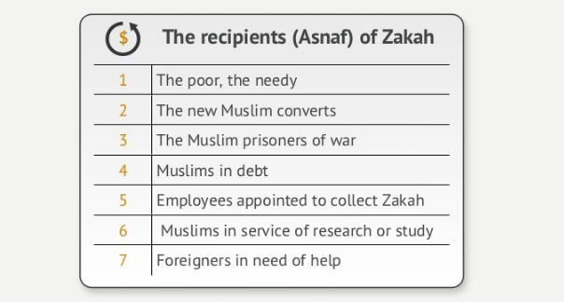
The Recipients (Zakah)

Slide 8
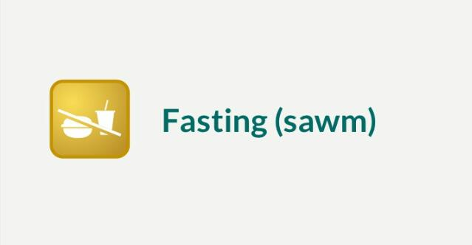
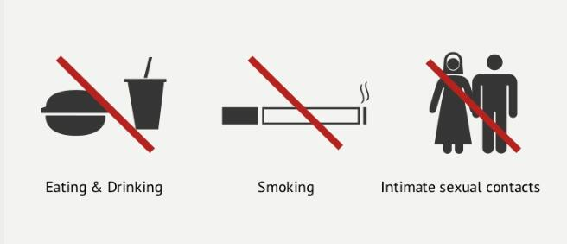
Fasting (Swam)
Fasting is abstaining completely from eating, drinking, intimate sexual contacts and smoking from the break of dawn till sunset.
The Prophet (SAW) said:
“There is a gate in Paradise called Ar. Rayan, and those who observe fasts will enter through it on the Day of Resurrection and none except them will enter through it. It will be said, ‘Where are those who use to observe fasts?’ They will get up, and none except them will enter through it. after their entry the gate will be closed and no one will enter through it”

Slide 9
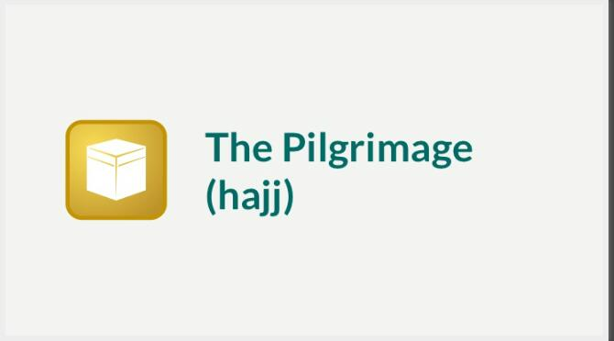
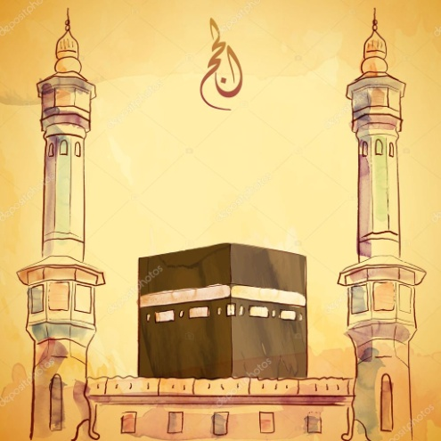
The Pilgrimage (Hajj)
It is a Pilgrimage to Mecca, at least once in a lifetime and it is obligatory upon every Muslim male and female who is mentally, physically and financially fit.
Muslims from all walks of life, from every corner of the globe assemble in Mecca in response to the call of Allah.
There is no royalty, but there is loyalty of all to Allah , the creator.

Slide 10


